Slide 1
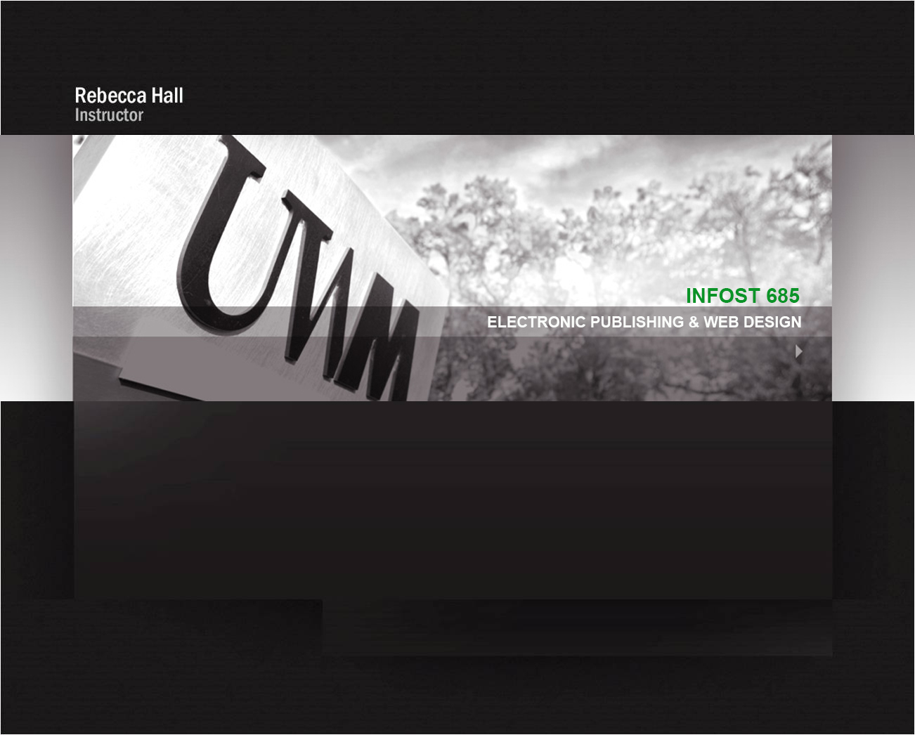


Slide 2
CSS Layout Techniques
Flexible Box Layout Module - Flexbox
  CSS Layout Module – offers greater control over arranging components of web page items along one axis (Ex: menu bars, product listings, galleries)
Advantages of Flexbox
Ability to “flex” – stretch or shrink inside their containers
Ability to make all neighboring items the same height
Easy horizontal and vertical centering
Ability to change the display order of items independent of the html source
*Browser Support – older browsers require prefixes/additional code for flexbox to work properly

Slide 3
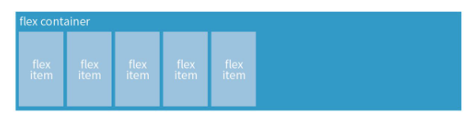
CSS Layout - Flexbox
Flexbox Container
you create a flex container by setting the element’s display property to flex
Figure 16-2. Niederst, J. (2018). Learning Web Design. O'Reilly Media, Inc.
.flex-container {
display: flex;
}
.flex-container {
display: inline-flex;
}
/* or */
Display: flex creates a block-level flex container
Display: inline-flex creates an inline-level flex container

Slide 4
CSS Layout - Flexbox
Flex container - Flex items
applying the flex display mode turns the child elements of the flex container into flex items
Figure 16-2. Niederst, J. (2018). Learning Web Design. O'Reilly Media, Inc.
Note: You can turn any flex item into a flex container by setting its display to flex (resulting in nested flexbox)

Slide 5
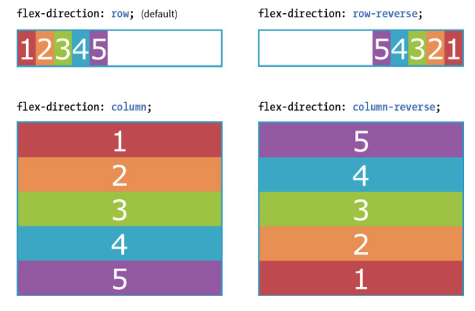
CSS Layout - Flexbox
Flex container - Properties
flex container properties allow you to control how items appear within the container
flex-direction
  row | column | row-reverse | column-reverse
Figure 16-3. Niederst, J. (2018). Learning Web Design. O'Reilly Media, Inc.

Slide 6
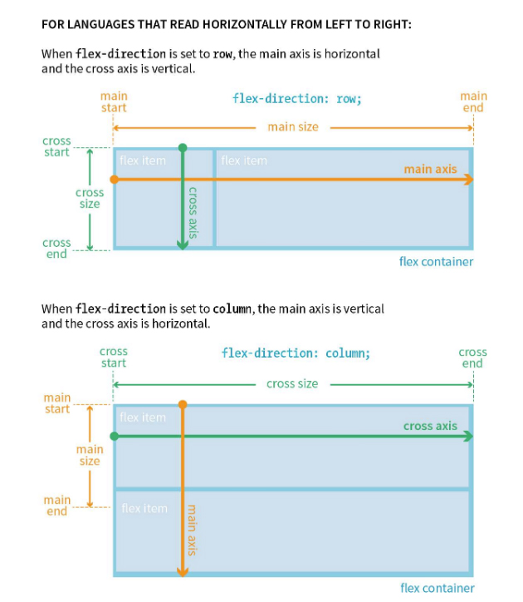
CSS Layout - Flexbox
flex items
flex items line up along one axis
main axis -or- cross axis
The main axis is the flow direction you’ve specified for the flex container. The cross axis is perpendicular to the main axis
Note: axis direction is specific to the direction of the writing system in use.
For example: In horizontally oriented languages – “row” would align items horizontally
Vertically oriented languages – “row” would align items vertically
Figure 16-4. Niederst, J. (2018). Learning Web Design. O'Reilly Media, Inc.

Slide 7
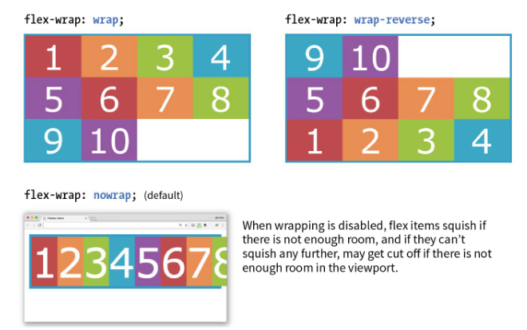
CSS Layout - Flexbox
flex-wrap
  nowrap | wrap | wrap-reverse
Figure 16-5. Niederst, J. (2018). Learning Web Design. O'Reilly Media, Inc.
THE MARKUP
<div id=“container”>
<div class=“box box1”> 1</div>
<!– more boxes here →
<div class=“box box10”> 10 </div>
</div>
THE STYLES
#container {
display: flex;
flex-direction: row;
flex-wrap: wrap;
}
.box {
width: 25%;
}

Slide 8
CSS Layout - Flexbox
flex-wrap
  nowrap | wrap | wrap-reverse
Figure 16-5. Niederst, J. (2018). Learning Web Design. O'Reilly Media, Inc.

Slide 9
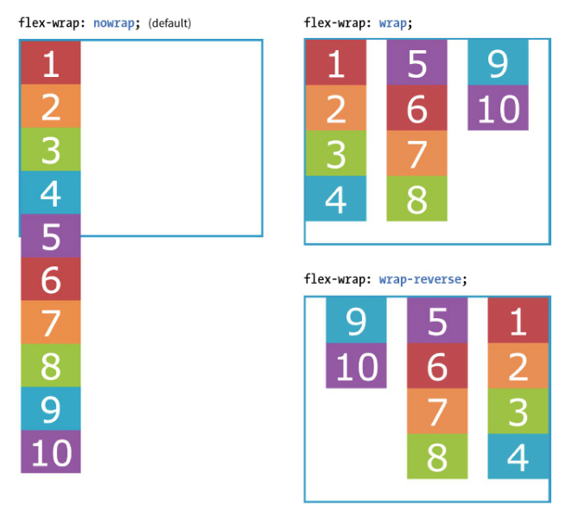
CSS Layout - Flexbox
flex-wrap
  nowrap | wrap | wrap-reverse
THE MARKUP
<div id=“container”>
<div class=“box box1”> 1</div>
<!– more boxes here →
<div class=“box box10”> 10 </div>
</div>
THE STYLES
#container {
display: flex;
height: 350px;
flex-direction: column;
flex-wrap: wrap;
}
.box {
width: 25%;
}
Figure 16-6. Niederst, J. (2018). Learning Web Design. O'Reilly Media, Inc.

Slide 10
CSS Layout - Flexbox
flex-flow (shorthand)
  flex-direction flex-wrap
Using flex-direction & flex-wrap
#container {
display: flex;
height: 350px;
flex-direction: column;
flex-wrap: wrap;
}
Using flex-flow
#container {
display: flex;
height: 350px;
flex-flow: column wrap;
}

Slide 11
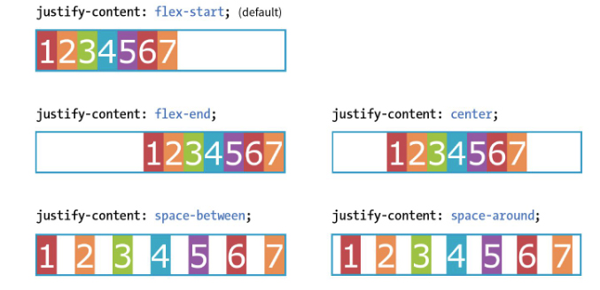
CSS Layout - Flexbox
Flexbox Alignment Properties
justify-content
  flex-start | flex-end | center | space-between | space-around
Flex items are, by default, as wide as they need to be to contain the element’s content.
The justify-content property defines how extra space is distributed around or between items
Figure 16-8. Niederst, J. (2018). Learning Web Design. O'Reilly Media, Inc.

Slide 12
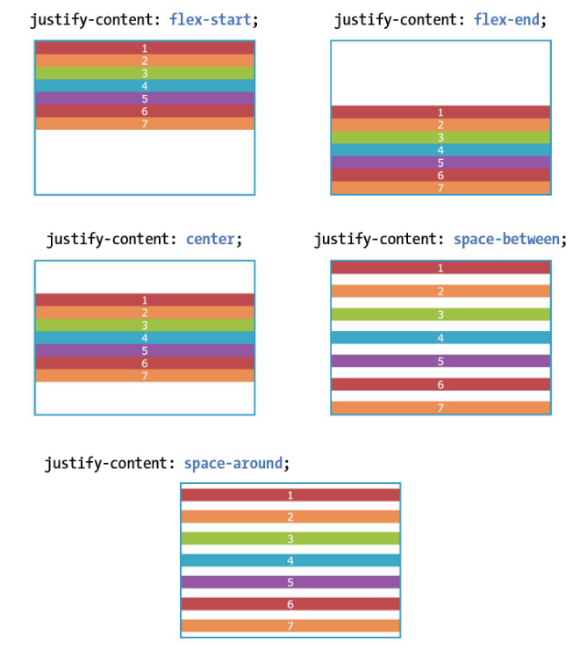
CSS Layout - Flexbox
justify-content
  flex-start | flex-end | center | space-between | space-around
Flex items are, by default, as wide as they need to be to contain the element’s content.
The justify-content property defines how extra space is distributed around or between items
Figure 16-8. Niederst, J. (2018). Learning Web Design. O'Reilly Media, Inc.

Slide 13
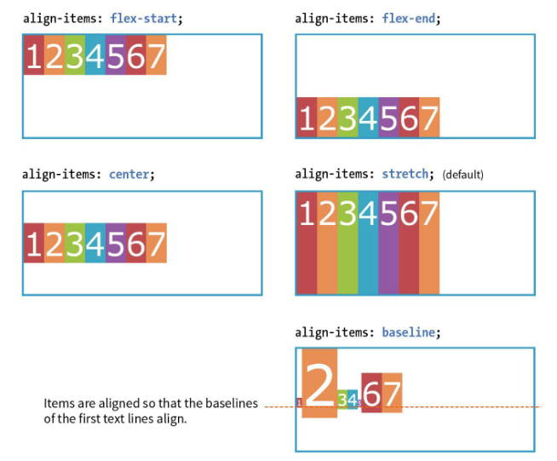
CSS Layout - Flexbox
Flexbox Alignment Properties
align-items
  flex-start | flex-end | center | baseline | stretch
The align-items property allows you to arrange items on the cross axis (up and down when the direction is row, left and right if the direction is column)
*Note: you must specify a container height
Figure 16-10. Niederst, J. (2018). Learning Web Design. O'Reilly Media, Inc.

Slide 14
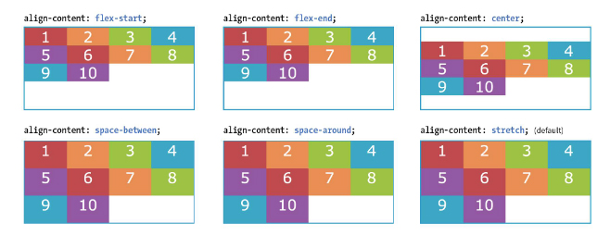
CSS Layout - Flexbox
Flexbox Alignment Properties
align-content
  flex-start | flex-end | center | space-around | space-between | stretch
Figure 16-10. Niederst, J. (2018). Learning Web Design. O'Reilly Media, Inc.
The align-content property applies only when there are multiple wrapped flex lines

Slide 15
CSS Layout - Flexbox
Flex item - Properties
flex item properties determines how space is distributed within items
flex
  None | ‘flex-grow flex-shrink flex-basis’
Flex: flex-grow flex-shrink flex-basis
Example
li {
flex: 1 0 200px
}
Example
This list item starts at 200px wide
is allowed to grow to fill extra space
is NOT allowed to shrink below 200px
Values of 1 and 0 work as on/off switch
1 “turns on” or allows an item to grow or shrink
0 “turns off” prevents item from growing or shrinking

Slide 16
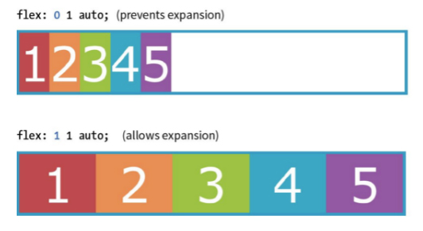
CSS Layout - Flexbox
Flex item - Properties
flex-grow
  Value: number Default: 0
THE MARKUP
<div id=“container”>
<div class=“box box1”> 1</div>
<div class=“box box2”> 2</div>
<div class=“box box3”> 3</div>
<div class=“box box4”> 4</div>
<div class=“box box5”> 5 </div>
</div>
THE STYLES
.box {
…
flex: 1 1 auto;
}
Figure 16-18. Niederst, J. (2018). Learning Web Design. O'Reilly Media, Inc.

Slide 17
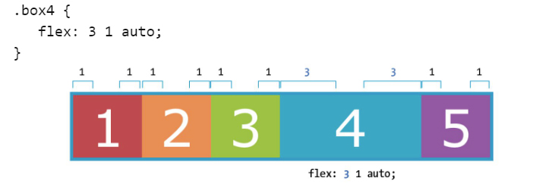
CSS Layout - Flexbox
Flex item - Properties
flex-grow
  Value: number Default: 0
Assigning a higher integer to an item – applies more space within that item.
A flex-grow value of “3” means the item receives three times the amount of space than the remaining items set to flex-grow: 1
Figure 16-19. Niederst, J. (2018). Learning Web Design. O'Reilly Media, Inc.

Slide 18
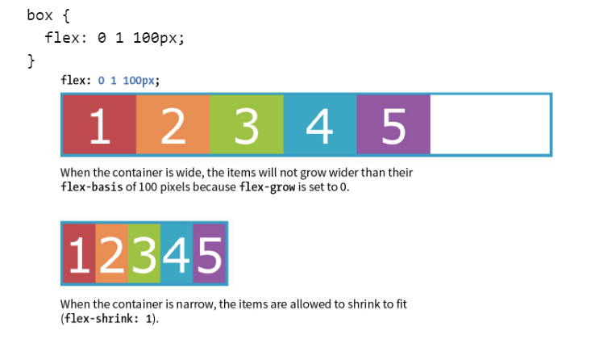
CSS Layout - Flexbox
Flex item - Properties
flex-shrink
  Value: number Default: 1
When flex-shrink is 0, items are not permitted to shrink and may hang out of their containing element
Flex items stop shrinking when they reach their minimum size (defined by min-width/min-height).
Figure 16-20. Niederst, J. (2018). Learning Web Design. O'Reilly Media, Inc.

Slide 19
CSS Layout - Flexbox
Flex item - Properties
flex-basis
  Value: length | percentage | content | auto
Flex-basis defines the starting size of an item before any wrapping, growing or shrinking occurs. It may be used instead of the width property (or height for columns) for flex items.
By default, flex-basis is set to auto (width/height value of item size)
If item’s size is not defined or set to auto – flex-basis uses the content width.
Figure 16-20. Niederst, J. (2018). Learning Web Design. O'Reilly Media, Inc.

Slide 20
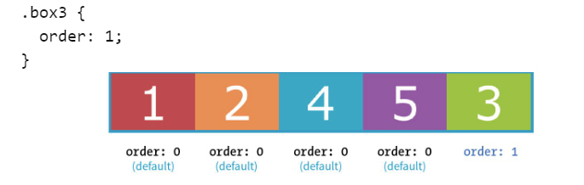
CSS Layout - Flexbox
Flex item - Properties
order
  Value: integer
The order property give the ability to display items in an order that is different from the order in the HTML source code.
If items have the same order value = laid out in order they appear in code
If items have different order values = arranged from the lowest order value to highest.
Figure 16-22. Niederst, J. (2018). Learning Web Design. O'Reilly Media, Inc.

Slide 21
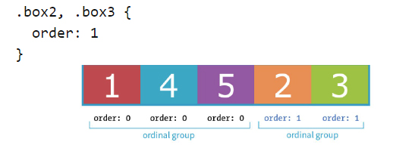
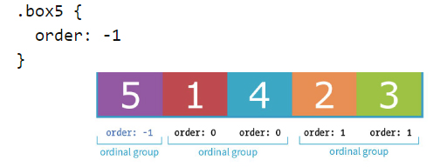
CSS Layout - Flexbox
Flex item - Properties
order
  Value: integer
Figure 16-23&24. Niederst, J. (2018). Learning Web Design. O'Reilly Media, Inc.

Slide 22
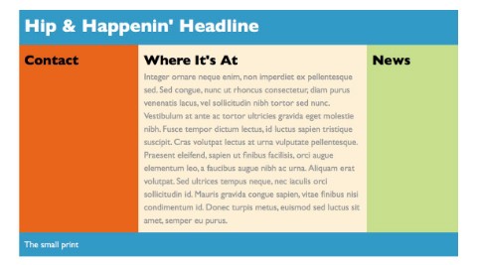
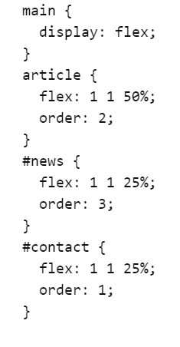
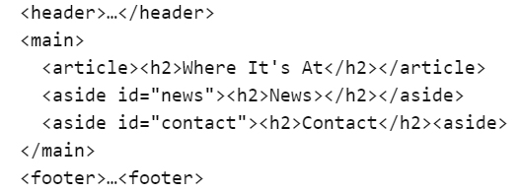
CSS Layout - Flexbox
Flex item - Properties
order
  Value: integer
Figure 16-25. Niederst, J. (2018). Learning Web Design. O'Reilly Media, Inc.

Slide 23
Let’s see how this works…

